Slide 1
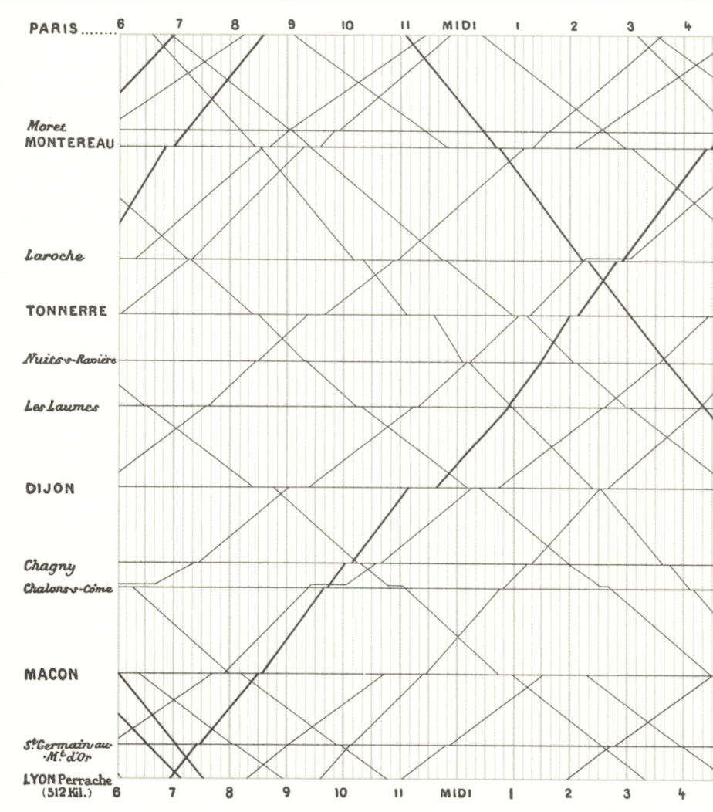
Visualization
as Science 1
A Samuel Pottinger
Stat 198: IDSV
Feb 10, 2025

Slide 2


Slide 3
Where are we?
History
Design
Science
Skills

Slide 4
Today
The eye: the structure and behavior essential for data visualization.
The stages of visual processing: how photons become information.
Contrast: how relative processing becomes important to visual understanding.
Preattentive features: how to draw attention quickly.

Slide 5
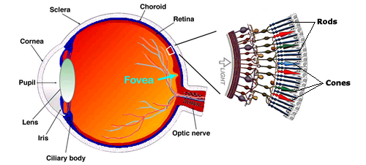
The eye
As we look across the structures of the eye, three important lessons emerge.
The “fovea” means we only see a very small area with sharpness at a time.
Our brain constructs an image over time.
Our vision is quite sharp for luminance. Hue is complicated.

Slide 6
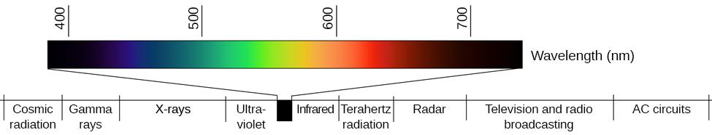
Sensitivities are skewed

Slide 7
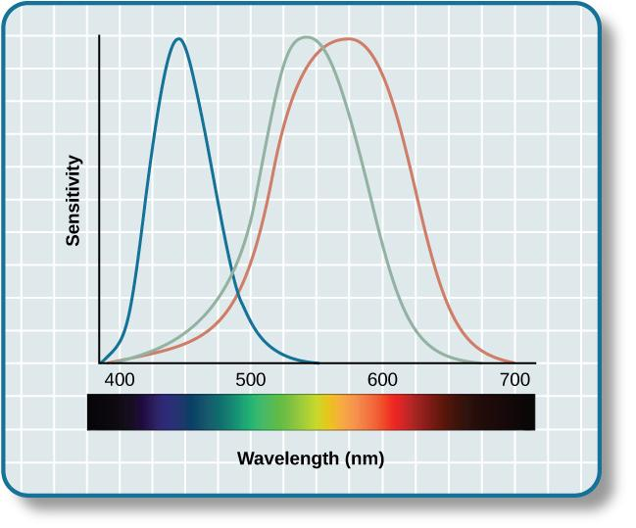
Sensitivities are skewed

Slide 8
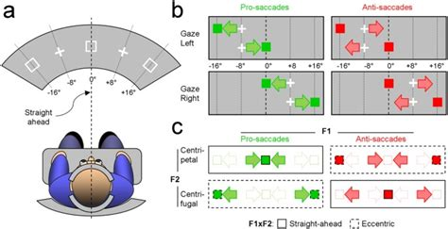
About saccades

Slide 9
Today
The eye: the structure and behavior essential for data visualization.
The stages of visual processing: how photons become information.
Contrast: how relative processing becomes important to visual understanding.
Preattentive features: how to draw attention quickly.

Slide 10
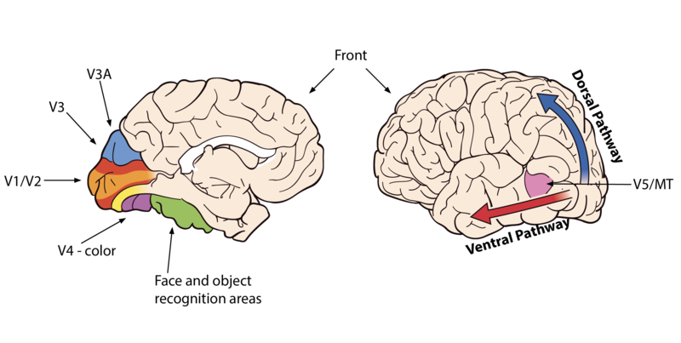
About the brain
“Where”
“What”

Slide 11
Two processes
Feature driven / bottom-up
vs
Context driven / top-down

Slide 12
Visual processing is fast, memory is limited
Having users remember visual items is hard.
We generally only get about 4 items which can be reliably remembered.
It is typically better to have a visual reference even if it is far away.

Slide 13
Visual processing is fast, memory is limited
We should avoid scanning as much as possible.
The fovea and visual memory are limited.
Manual scanning of a scene is slow. It is better to try to use something that the visual cortex is already good at identifying.

Slide 14
Visual processing is fast, memory is limited
Using structures can aid processing
The brain is trying to identify structure and features. Glyphs not pixels.

Slide 15
Visual processing is fast, memory is limited
Having users remember visual items is hard.
We generally only get about 4 items which can be reliably remembered.
It is typically better to have a visual reference even if it is far away.
We should avoid scanning as much as possible.
The fovea and visual memory are limited.
Manual scanning of a scene is slow. It is better to try to use something that the visual cortex is already good at identifying.
Using structures can aid processing
The brain is trying to identify structure and features. Glyphs not pixels.

Slide 16
Today
The eye: the structure and behavior essential for data visualization.
The stages of visual processing: how photons become information.
Contrast: how relative processing becomes important to visual understanding.
Preattentive features: how to draw attention quickly.

Slide 17
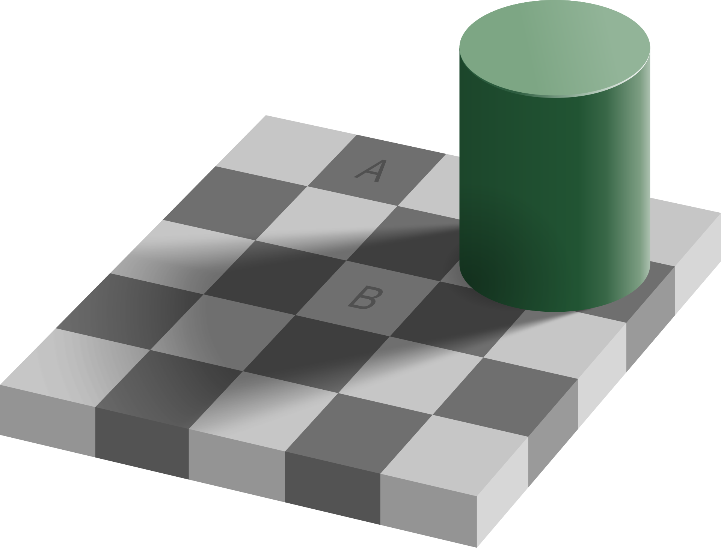
Contextual interpretation

Slide 18
Contextual interpretation

Slide 19

Role of contrast

Slide 20
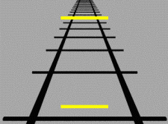
Role of expectations

Slide 21
Some lessons
Use structures: We will return to this in the next lecture but the “gestalt principles” let us use some of this machinery to make shortcuts. However, in general, consider the intentional and unintentional figures created by glyph proximity or connectedness.
Minimal contrast: If reliable reading of figure is required, ensure sufficient contrast to background (we will come back to this).
References: Manipulate borders to emphasize nearby contrast or absolute value.

Slide 22
Today
The eye: the structure and behavior essential for data visualization.
The stages of visual processing: how photons become information.
Contrast: how relative processing becomes important to visual understanding.
Preattentive features: how to draw attention quickly.

Slide 23
Preattentive features: Color

Slide 24
Preattentive features: Form and orientation

Slide 25
Preattentive features: Position and Motion
We are going to save 2.
These are the basic properties we can manipulate. However, we will come back to movement in game design / interactivity. We will come back to gestalt principles next lecture.

Slide 26
Preattentive features: Reminder
The preattentive features vary somewhat from author to author but see the reading for a pretty good list.

Slide 27
Group activity: school info
I have a small dataset on graduation rate and salary.
Work with a partner to use preattentive features to highlight Berkeley in a visualization.
We will share with another group in 10 minutes.
School | Graduation Rate | Annual Cost
Santa Clara University | 92% | 44000
Stanford University | 97% | 11000
California Institute of Technology | 94% | 17000
UC Berkeley | 94% | 17000
USC | 93% | 29000
UC Davis | 89% | 16000
Loyola Marymount University | 82% | 45000
San Jose State University | 75% | 14000
UC Santa Barbara | 86% | 15000
UC Irvine | 87% | 12000
UCLA | 93% | 16000
CA State Sacramento | 70% | 11000

Slide 28
Recap: what are some of the viz takeaways?
Having users remember visual items is hard. When possible, keep it visible.
We can use preattentive features to avoid scanning.
What we see depends on what is around it.
We can have things touch each other to emphasize relative comparison. We can create borders or consistent background to emphasize absolute value extraction.
Ensure sufficient contrast for feature extraction.

Slide 29
New language: Another look at next steps.
Science 2: More on preattention and color vision (color, gestalt principles).
Skills labs: Playing with visual processing (form, motion, and interaction).
Formalizing glyphs: Encoding (how we put info into graphics), decoding (how our brains get that info out). Revisit dimensions and attributes.

Slide 30
Works Cited
B. Adhikari, "Marey's train schedule," University of Missouri Saint Louis, 2021. Available: https://badriadhikari.github.io/data-viz-workshop-2021/minards/
S. Bell, “Introduction and Perceptual Elements of Colour,” University of Saskatchewan. Available: https://openpress.usask.ca/introgeomatics/chapter/introduction-and-perceptual-elements-of-colour/
J. Harvey, “The evolution of the human eye,” TED Ed, 2015. Available: https://www.youtube.com/watch?v=qrKZBh8BL_U
D. Camors, Y. Trotter, P. Pouget, S. Gilardeau & J. Durand, “Visual straight-ahead preference in saccadic eye movements,” Nature Communications, 2016. Available: https://www.nature.com/articles/srep23124
OSC Rice, “Vision,” Washington State University. Available: https://opentext.wsu.edu/psych105nusbaum/chapter/vision/
“Vision,” CourseHero. Available: https://www.coursehero.com/study-guides/wmopen-psychology/outcome-vision/
E. Adelson, “Checker shadow illusion,” Wikimedia, 2018. Available: https://en.wikipedia.org/wiki/Checker_shadow_illusion#/media/File:Checker_shadow_illusion.svg
DancingPhilosopher, “Mach Bands,” Wikimedia, 2012. Available: https://en.wikipedia.org/wiki/Optical_illusion#/media/File:Mach_bands_-_animation.gif
US Department of Education, “College Scorecard,” US Department of Education. Available: https://collegescorecard.ed.gov/search/?sort=salary:desc&page=0&state=CA
C. Ware, “Information Visualization: Perception for Design,” MK Press.
C. Ware, “Visual Thinking for Design,” MK Press.

Slide 31


